Slide 1
This template is preset to 48w x 36h.
Use page setup to change the dimensions.
The following design is an example and is NOT required for your presentation. Please feel free to modify it for your project and information.

Slide 2

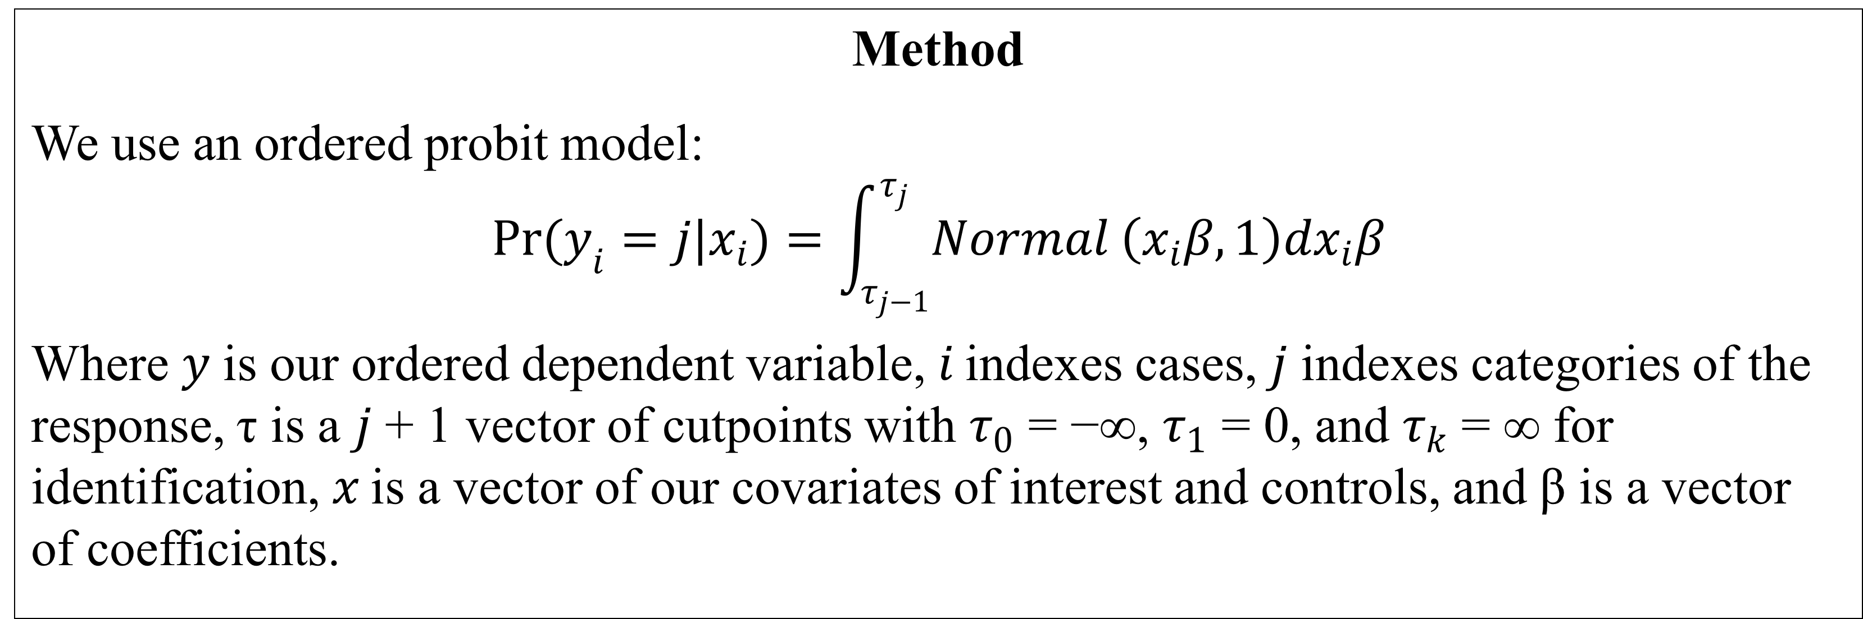
Title
Larry Koster, Beatrice Magistro, Steve Otterman
University of Washington, Political Science
lkoster@uw.edu, magistro@uw.edu, otters@uw.edu
Introduction
Hypothesis
Data
We use data from the May 2016 Eurobarometer 85.2 survey. Our ordered dependent variable is:
Better future outside of the EU (Strongly agree, Agree, Disagree, Strongly disagree).
Our covariates of interest are:
Feeling towards EU immigration and Feeling towards non-EU immigration. (SA, A, D, SD).
Our controls include:
Financial situation of the household (Very good, Rather good, Rather bad, Very bad); Globalization is an opportunity (SA, A, D, SD); gender (1 male and 0 female); age; education years (age at which a person finished education); left to right scale ( 0 – extreme left to 10 – extreme right); and Occupation scale (self-employed, managers, other white collars, manual workers, house persons, unemployed, retired and students).
Results

